Slide 1

The Green Ledgers
Carbon Credit Marketplace Simulator
Team Members:
• Dakshraj Singh Chandawat
• Tejas Pebam
• Laishram Ritikumar Singh
Alliance University | 1M1B Green Internship · Batch 7 · March 2026
Notes:
1

Slide 2
Introduction to Carbon Credits
Climate change is one of the biggest global challenges today and is mainly caused by greenhouse gas emissions such as carbon dioxide. A carbon credit represents the reduction or removal of one ton of carbon dioxide from the atmosphere. Companies and individuals can purchase these credits to offset their emissions and reduce their environmental impact. Global standards for carbon credits are managed by organizations like Verra and Gold Standard, which verify and certify carbon reduction projects.
Notes:
2

Slide 3
Problem Statement
Although carbon offsetting is an important tool for climate action, many organizations and individuals find it difficult to participate in carbon markets. This is mainly because carbon trading platforms are often complex, difficult to access, and not widely understood. As a result, many people who want to reduce their carbon footprint do not take action due to the lack of simple and accessible platforms.
Key Issues
Limited access to carbon trading platforms
Lack of awareness about carbon credit systems
Complex trading processes
Difficulty tracking carbon offset impact
Notes:
3

Slide 4
Proposed Solution
To address this problem, our project proposes a Carbon Offset Marketplace Simulation. This platform will demonstrate how a carbon credit marketplace works by allowing users to browse carbon projects, purchase carbon credits, sell credits, and track their carbon offset portfolio. The simulation will help users understand the process of carbon trading and encourage participation in sustainability initiatives.
Key Features
Browse carbon offset projects
Buy carbon credits
Sell carbon credits
Track carbon credit portfolio
Retire credits to offset emissions
Notes:
4

Slide 5
Project Objectives (Goals)
Specific
Build a simulated carbon credit marketplace.
Measurable
Track the number of credits traded and CO₂ offset.
Achievable
Use tools like HTML/CSS, Tableau, Google Forms, and Netlify.
Relevant
Supports sustainability awareness and carbon finance education.
Time-Bound
Complete the prototype within the internship timeline.
Notes:
5

Slide 6
System Architecture
Our project includes three main components.
User Interface
Marketplace designed and deployed as a live website using HTML, CSS, and JavaScript on Netlify.
Transaction Ledger
A CSV/database (5,000 records) to record and analyse carbon credit trades.
Data Visualization
Dashboards created using Tableau to show trading activity, emissions, and environmental impact.
Notes:
6

Slide 7
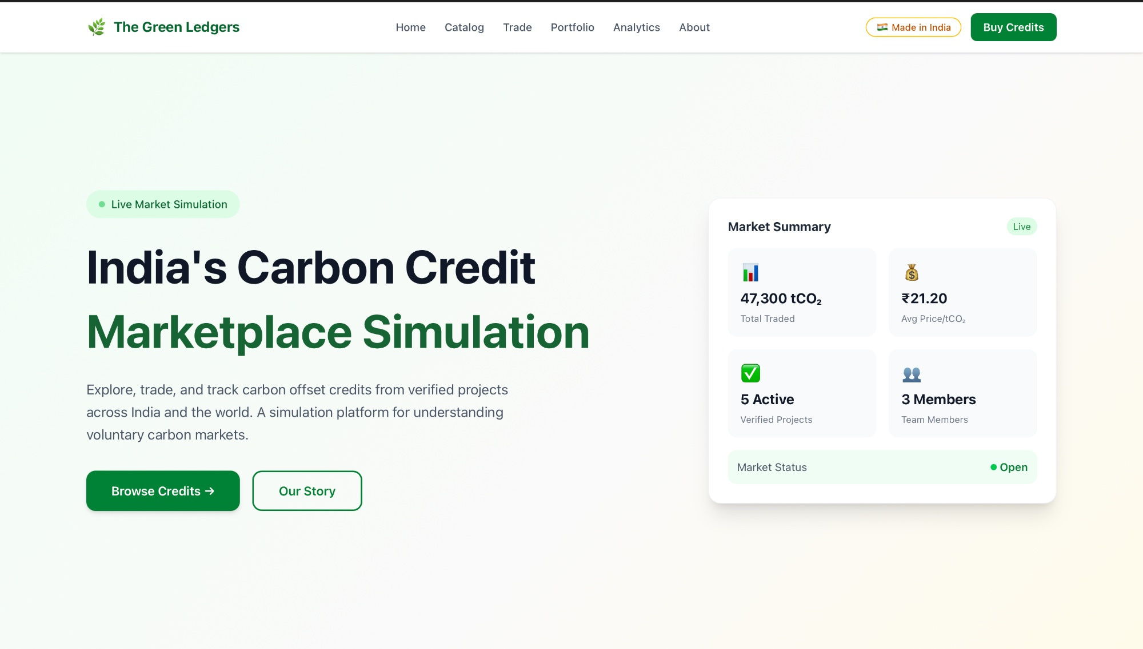
Live Website — The Green Ledgers
Click on the link to visit the website - https://keen-pika-1d8b45.netlify.app
Notes:
7

Slide 8
Website Features Overview
6 fully functional pages built and deployed
🏠 Home
📋 Catalog
Live market summary, 47,300 tCO₂ traded, ₹21.20 avg price, market status
6 verified projects with filter pills: India, Forestry, Solar, Wind, Water, Blue Carbon
💱 Trade
📊 Portfolio
Buy/Sell/Retire tabs with GST (18%), platform fee, UPI/Cards/NEFT payments
2,840 tCO₂ offset, holdings tracker, 56.8% goal progress bar
📈 Analytics
👥 About
847 transactions, 83% verified, credits by industry, buy vs sell volume charts
Mission, problem, solution, team profiles — Dakshraj, Tejas, Laishram
Notes:
8

Slide 9
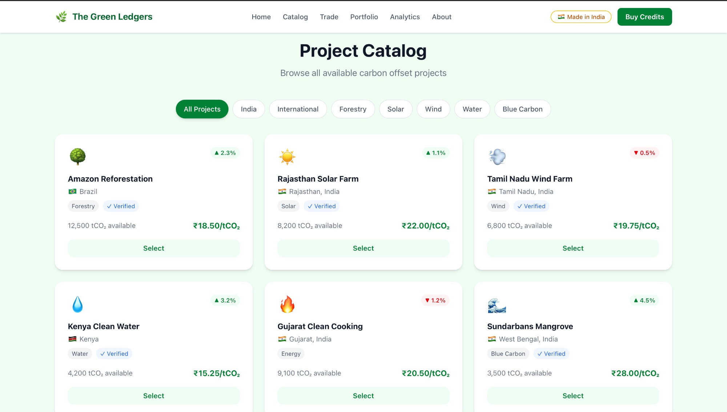
Credit Catalog — 6 Verified Projects
Filterable by: All Projects · India · International · Forestry · Solar · Wind · Water · Blue Carbon
Amazon Reforestation · Rajasthan Solar · Tamil Nadu Wind · Kenya Water · Gujarat Cooking · Sundarbans Mangrove
Notes:
9

Slide 10
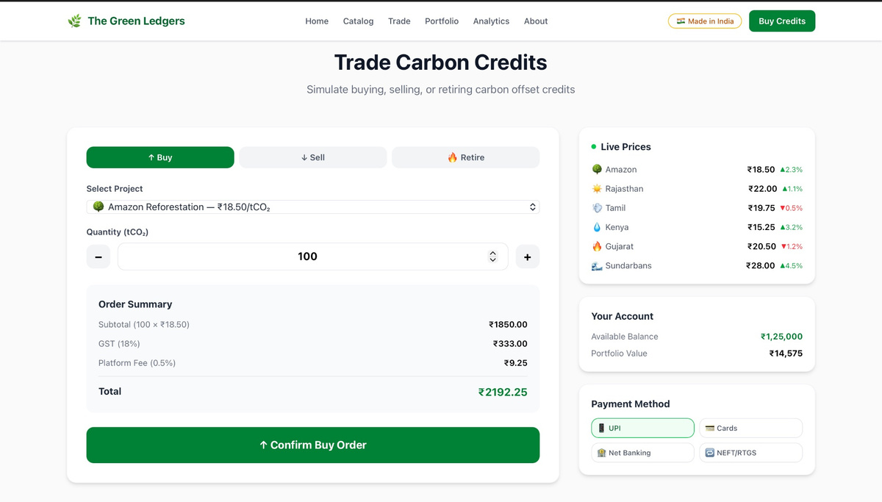
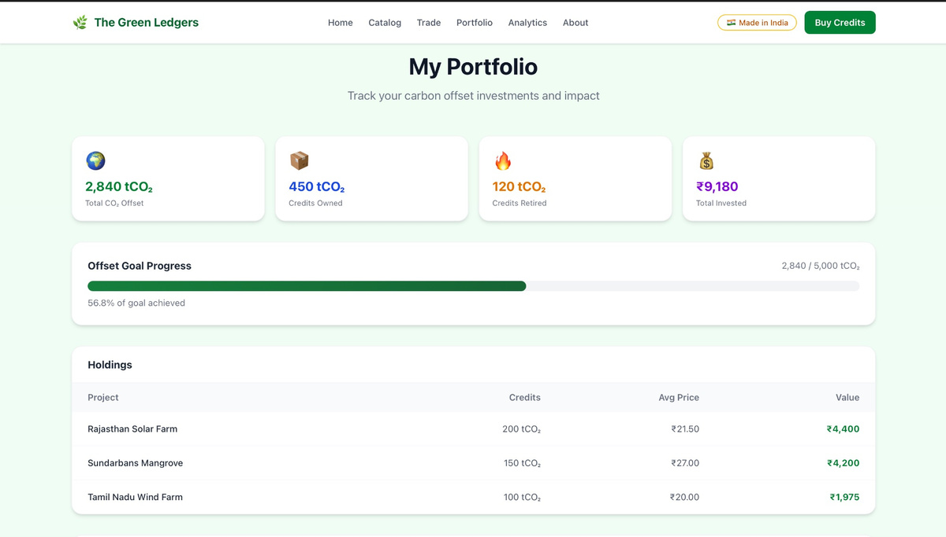
Trade & Portfolio Dashboard
Buy / Sell / Retire credits with live price calculation including GST
Trade Page — Buy/Sell/Retire with GST & UPI
Portfolio — 2,840 tCO₂ offset · ₹9,180 invested
Notes:
10

Slide 11
Dataset Used
Dataset Name: Carbon Trading Transactions Dataset
Source: Kaggle | 5,000 records | 15 variables | 2024–2025 data
Key Variables Used:
Date (2024–2025)
Carbon Price (USD/tCO₂) — range $20–$35
Industry Type (Steel, Energy, Cement, Manufacturing)
Emission Produced & Allowance (tCO₂)
Transaction Type (Buy/Sell), Credits Traded, Verification Status
Compliance Cost & Carbon Cost Savings (USD)
Notes:
11

Slide 12
Tools and Technologies
HTML / CSS / JavaScript
— Website development — fully interactive 6-page marketplace
Netlify
— Website deployment — live public URL, free hosting
Tableau Public
— Data visualization and dashboard development
Excel / CSV Dataset
— Data storage and preparation — 5,000 transaction records
Google Forms
— Stakeholder survey collection — 17 respondents
Canva / Claude AI
— Presentation design and content generation
Notes:
12

Slide 13
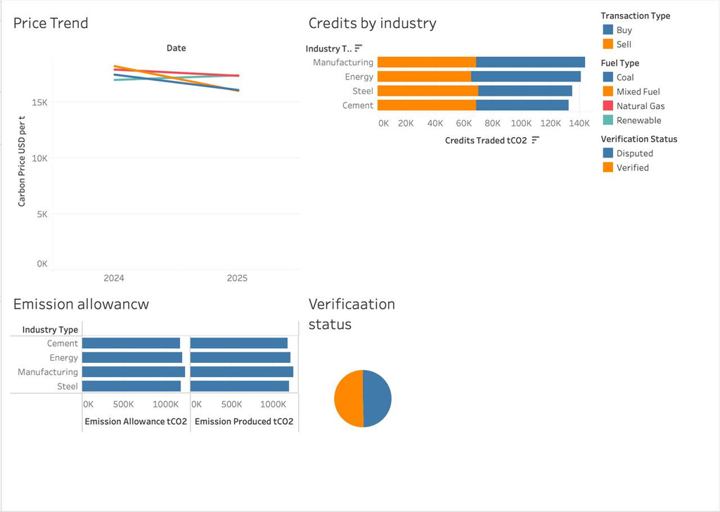
Dashboard Visualization (Tableau)
Overall Purpose:
Support decision-making for carbon market participants, regulators, and environmental analysts.
Help track emission compliance and market trends.
Identify risk areas (disputed credits) and opportunities.
Assist industries in managing their carbon footprint relative to allowances.
Notes:
13

Slide 14
Real Data Insights from Dataset
5,000 actual transaction records · carbon_trading_dataset.csv · Kaggle
5,000
$27.53
5,51,944
50.5%
Total transactions
Avg price/tCO₂
tCO₂ total traded
Verified trades
Manufacturing leads —
1,43,685 tCO₂ — highest trading volume across all 4 industries
Natural Gas top fuel —
1,281 trades — followed by Renewable (1,248) and Mixed (1,244)
Buy dominates —
2,531 Buy vs 2,469 Sell transactions — balanced market simulation
3 market scenarios —
High Demand (1,675) · Price Surge (1,672) · Low Demand (1,653)
Avg compliance cost —
$12,480 per transaction · Avg carbon cost savings: $1,740
Notes:
14

Slide 15
Stakeholder Survey Results
Google Forms survey · 17 respondents · Alliance University · March 2026
17
92%
100%
4.5/5
Respondents
Rated platform important (5/5)
Aged 18–24 years
Avg overall rating
Key Findings:
71% of respondents have a basic idea of carbon credits — platform fills an education gap
Top feature requested: Verified project listings with credibility scores (selected by all)
Most preferred trading flow: Browse → Select → Confirm → Ledger updates (10/17 votes)
Top improvement suggestion: Real-time carbon impact dashboard (60%+ respondents)
Blockchain ledger preferred by 8/17 · Relational database by 5/17 respondents
Notes:
15

Slide 16
Stakeholder List
17 respondents who participated voluntarily · Survey conducted 15 March 2026
Abhishek
Tejas
Rajnandini
BA - Political Science
BBA
BBA
Abhithsa
Dakshraj
Shush
BBA
BCA
BBA
Adarsh
Nishkarsh
Raghav
BCA
Aerospace Engineering
BA - LLB
Meet
Aastha
Rounit
BBA
BBA
BA - LLB
Prem
Mahir
Shivansh
BCA
BCA
BA - LLB
Kavit
Ananya
BBA
Entrepreneur
Notes:
16

Slide 17
Impact Metrics
Real numbers from dataset and stakeholder survey
The impact of our project is measured using:
5,51,944 tCO₂
Total credits traded across 5,000 simulated transactions in the dataset
$27.53 / tCO₂
Average carbon price — real market-aligned figure from Kaggle dataset
1 credit = 1 tCO₂
Every credit offset = 1 metric tonne of CO₂ removed from atmosphere
92% stakeholders
Rated the platform as highly important for climate action (survey)
SDG 13
Supporting UN Sustainable Development Goal 13: Climate Action
Notes:
17

Slide 18
Conclusion
In conclusion, The Green Ledgers Carbon Marketplace Simulation successfully demonstrates how a carbon credit marketplace works — making carbon trading simple, transparent, and accessible. The project was built as a fully deployed website with 6 interactive pages, a live trading interface with INR pricing and GST calculation, a portfolio dashboard, and real data analytics powered by 5,000 transaction records from Kaggle.
With 17 stakeholders surveyed and 92% rating the platform as highly important, the project proves strong real-world relevance. In the future, this system could be expanded by integrating real carbon market data, blockchain-based credit tracking, and advanced analytics to support real-world carbon trading platforms.
Notes:
18

Slide 19
THANK YOU
🌿 The Green Ledgers — Making Carbon Markets Accessible for Every Indian 🇮🇳
1M1B Green Internship · Batch 7 · Alliance University · March 2026 · Supporting SDG 13: Climate Action
Notes:
19

